Slide 1


Lecture 3
Produced by Dr. Worldwide
Welcome to the 305
~
~

Slide 2

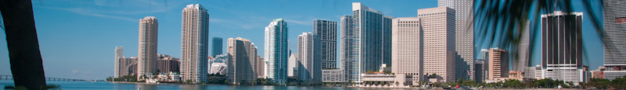
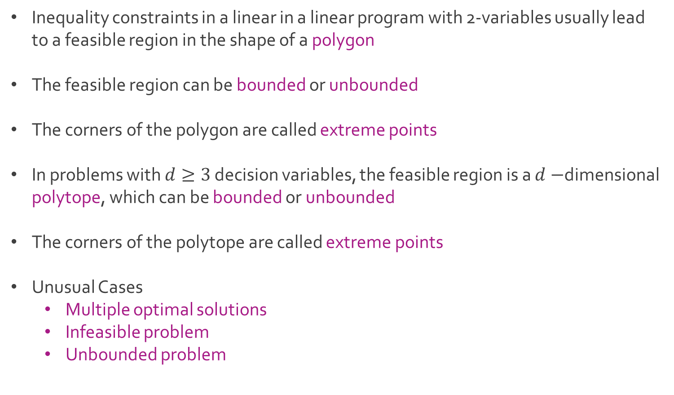
Linear Programming
Inequality constraints in a linear in a linear program with 2-variables usually lead to a feasible region in the shape of a polygon
The feasible region can be bounded or unbounded
The corners of the polygon are called extreme points
In problems with $d≥3$ decision variables, the feasible region is a $d−$dimensional polytope, which can be bounded or unbounded
The corners of the polytope are called extreme points
Unusual Cases
Multiple optimal solutions
Infeasible problem
Unbounded problem

Slide 3
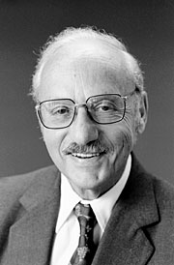

Simplex Algorithm
Theorem: If a linear program has an optimal solution, then it always has an optimal solution which is an extreme point
The simplex algorithm was designed by George Dantzig to solve linear programs
Intelligently explores the feasible region to find extreme points
Useful for linear programs in standard form
First an extreme point must be identified
If this point is not optimal, then an edge exists to
Another extreme point where the objective function
becomes closer to optimal
Maximize $c^{T}x$
Subject to $Ax≤b$
$$x≥0$$

Slide 4
Ex: The Possibility Restaurant
Angela Fox and Zooey Caulfield studied food and nutrition at UNC
They want to open a French restaurant in Chapel Hill called The Possibility
Unaware of the local customer’s tastes, they decide to serve only 2 full-course meals around beef and fish
Chef Pierre plans to experiment with different appetizers, soups, salads, deserts, etc. to identify the best selection of menu items
Q: What considerations exist for Angela and Zooey to optimize their business?

Slide 5
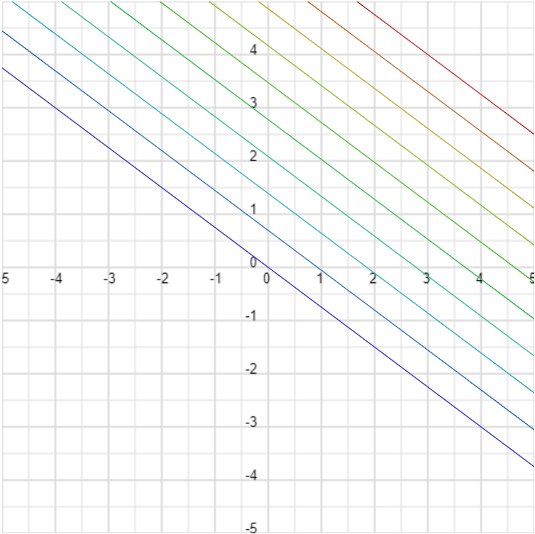
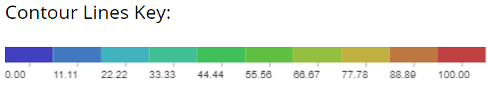
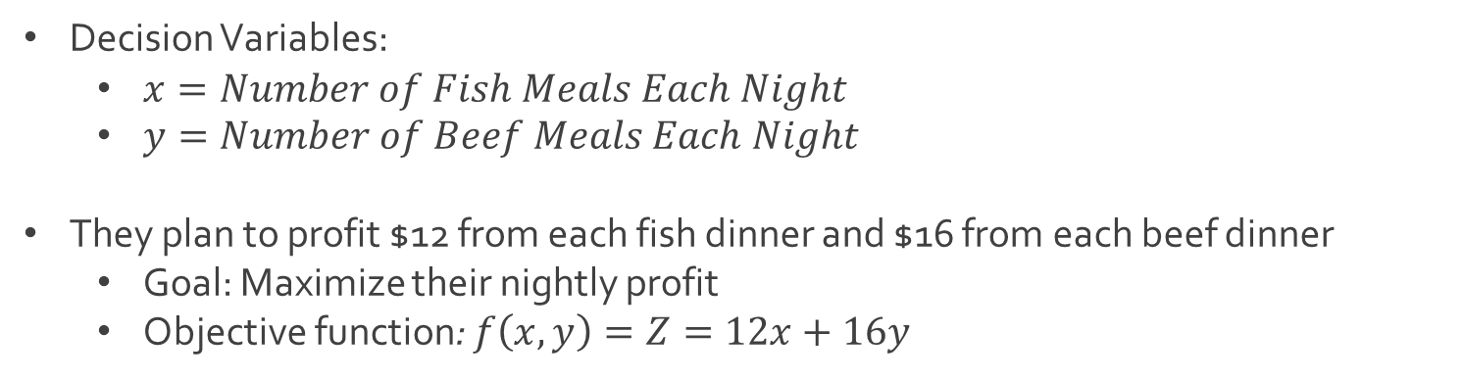
Ex: The Possibility Restaurant
Decision Variables:
$x=Number of Fish Meals Each Night$
$y=Number of Beef Meals Each Night$
They plan to profit $12 from each fish dinner and $16 from each beef dinner
Goal: Maximize their nightly profit
Objective function: $f\left(x,y\right)=Z=12x+16y$

Slide 6
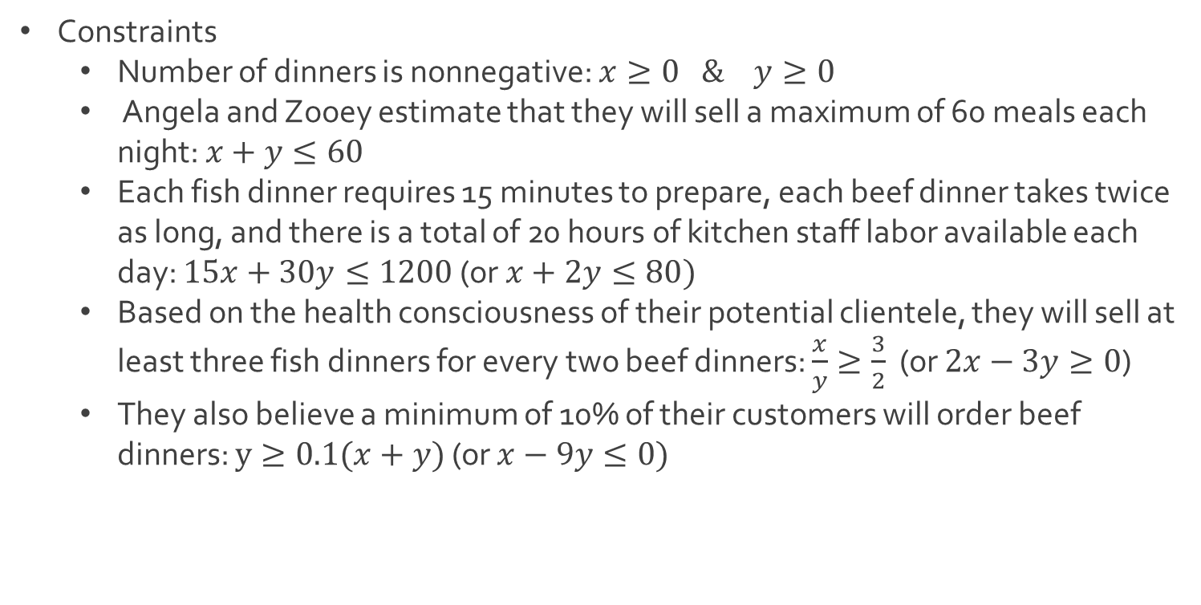
Ex: The Possibility Restaurant
Constraints
Number of dinners is nonnegative: $x≥0 \& y≥0$
Angela and Zooey estimate that they will sell a maximum of 60 meals each night: $x+y≤60$
Each fish dinner requires 15 minutes to prepare, each beef dinner takes twice as long, and there is a total of 20 hours of kitchen staff labor available each day: $15x+30y≤1200$ (or $x+2y≤80)$
Based on the health consciousness of their potential clientele, they will sell at least three fish dinners for every two beef dinners: $\frac{x}{y}≥\frac{3}{2}$ (or $2x−3y≥0$)
They also believe a minimum of 10% of their customers will order beef dinners: $y≥0.1(x+y)$ (or $x−9y≤0)$

Slide 7

Ex: The Possibility Restaurant
Complete linear program
Since there are 2 decision variables, we can solve it graphically
Maximize $12x+16y$
Subject to $x+y≤60$
$x+2y≤80$
$2x−3y≥0$
$x−9y≤0$
$x≥0$
$y≥0$

Slide 8
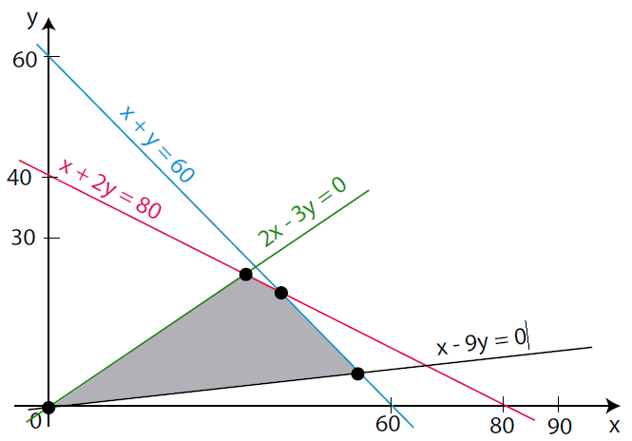
Ex: The Possibility Restaurant
Graph of feasible region (use origin to determine which side to shade)

Slide 9


Ex: The Possibility Restaurant
Find the corners of the feasible region
Origin: $(0,0)$
Intersection of Green and Red: $\left(34.3,22.8\right)$
Intersection of Blue and Red: $\left(40,20\right)$
Intersection of Blue and Black: $\left(54,6\right)$
$$2\left(80−2y\right)−3y=0$$
$$160−4y−3y=0$$
$$160−7y=0$$
$$y=\frac{160}{7}=22.8$$
$x=80−2y=80−2\left(22.8\right)=34.3$

Slide 10
Ex: The Possibility Restaurant
Evaluate objective function at extreme points
x | y | 12x+16y
0 | 0 | 0
34.3 | 22.8 | 776.4
40 | 20 | 800
54 | 6 | 744

Slide 11
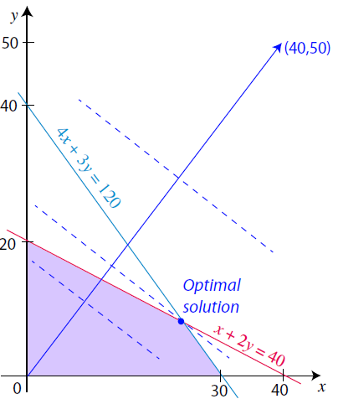
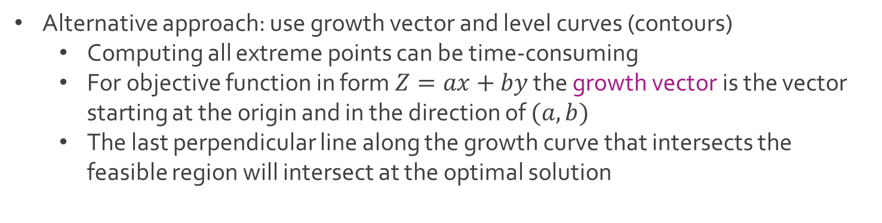
Ex: The Possibility Restaurant
Alternative approach: use growth vector and level curves (contours)
Computing all extreme points can be time-consuming
For objective function in form $Z=ax+by$ the growth vector is the vector starting at the origin and in the direction of $(a,b)$
The last perpendicular line along the growth curve that intersects the feasible region will intersect at the optimal solution

Slide 12




The End
Dale

